Slide 1
TUT08 – Memory Hierarchy COMP1411: Introduction to Computer Systems
Dr. Mingsong LYU
Department of Computing
The Hong Kong Polytechnic University
Spring 2023
These slides are only intended to use internally. Do not publish it anywhere without permission.

Slide 2
Targets
Locality
Cache design, and how it affects performance
Block size
Replacement policy
Space management

Slide 3
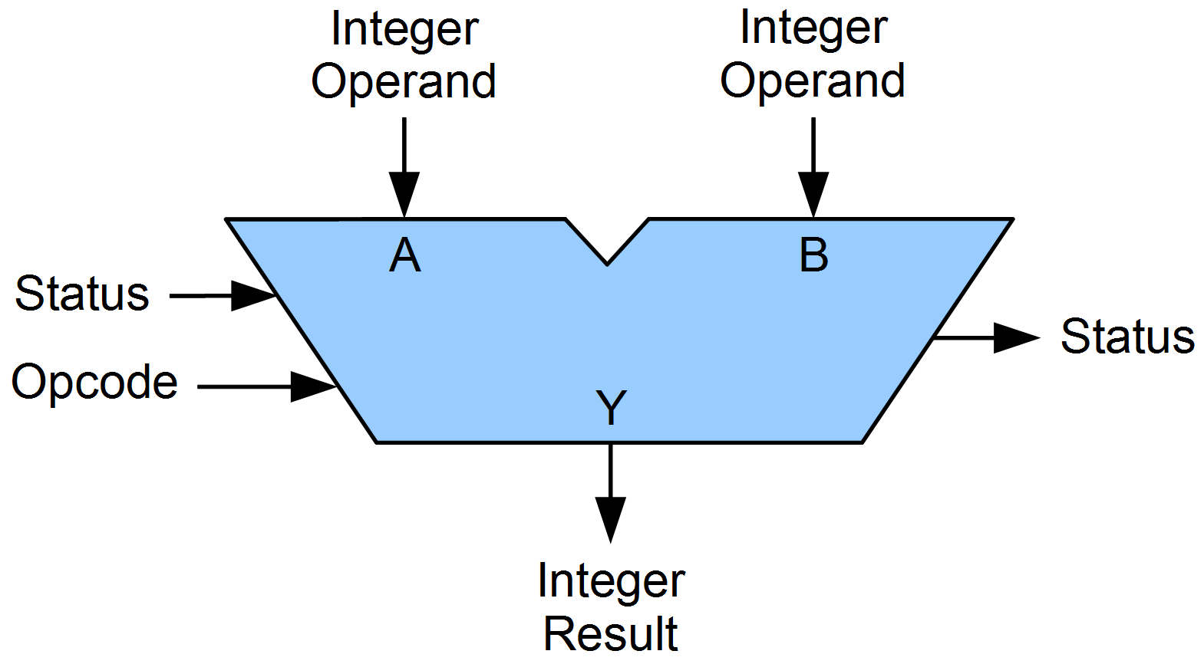
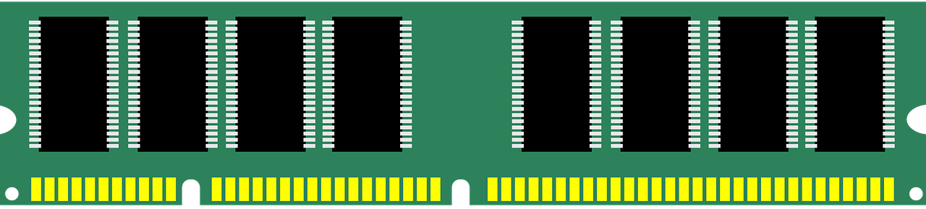
More on cache design
Adding a small but fast memory inside the CPU
To execute an instruction
I need data A
Is A in cache?
Fetch A from cache to register
Copy A from memory to register
cache
Fetch A from cache to register
Execute instruction
Cache hit
1+ cycles to fetch data
Cache miss
100+ cycles to fetch data

Slide 4
Problem 1
given the following function in the C language
Assume that the address of the array a is 0x0000; the size of int is 4 bytes.
Calculate the address of the following elements
a[0][0], a[2][0], a[0][3], a[2][3]
#define N 100
int sumarray3d(int a[N][N])
{
int i, k, sum=0;
for (i=0;i<N;i++) {
for (k=0;k<N;k++) {
sum += a[k][i];
}
}
return sum;
}

Slide 5
Solution to Problem 1
a[100][100], size of int = 4B
Starting address 0x0000
Allocation on memory: a[0][0], a[0][1], …, a[0][n], a[1][0], …
For a[i][j], the address of a = 0x0000 + (i * N + j) * 4
Element | address
a[0][0] | 0x0000 + (0 * 100 + 0) * 4 = 0x0000
a[2][0] | 0x0000 + (2 * 100 + 0) * 4 = 800 = 0x0320
a[0][3] | 0x0000 + (0 * 100 + 3) * 4 = 12 = 0x000C
a[2][3] | 0x0000 + (2 * 100 + 3) * 4 = 812 = 0x032C

Slide 6
Problem 2
Given the following function in the C language:
Rewrite the loops in order to improve the locality
#define N 1000
int sumarray3d(int a[N][N][N])
{
int i,j,k, sum=0;
for (i=0;i<N;i++) {
for (j=0;j<N;j++) {
for (k=0;k<N;k++) {
sum += a[k][i][j];
}
}
}
return sum;
}

Slide 7
Solution to Problem 2
#define N 1000
int sumarray3d(int a[N][N][N])
{
int i,j,k, sum=0;
for (i=0;i<N;i++) {
for (j=0;j<N;j++) {
for (k=0;k<N;k++) {
sum += a[k][i][j];
}
}
}
return sum;
}
for (k = 0…N)
for (i = 0…N)
for (j = 0…N)
sum += a[k][i][j]
a[k][i][0] → a[k][i][1] → …
Stride = 1
a[0][0][0] → a[1][0][0] → a[2][0][0], stride = 1,000,000

Slide 8
Problem 3
memory
Assume the following configuration for a processor with a cache:
Cache size = 16B
Cache block size = 4B or 8B
Data variable size = 4B
Allocation of data variables in the main memory =>
Evicting the earliest installed item when cache is full
The following access sequence for data variables is generated by a program
ACEGACEGBDFHBDFH
Please
Compute the number of cache hits and misses for the two different cache block sizes (8B or 16B)
Explain the results to evaluate cache block size design
A
B
C
D
E
F
G
H
Cache
Case 1
Cache
Case 2
4B
8B
4B
4B
8B
4B

Slide 9
Solution to Problem 3
ACEGACEGBDFHBDFH
Case 1: block size = 4B
A
A
A
A
A
A
A
C
C
E
C
G
C
A
C
C
C
M
M
M
E
M
E
H
E
H
E
G
G
G
A
A
A
B
B
B
B
C
E
C
G
C
B
C
D
D
F
D
H
D
E
H
E
H
E
M
E
M
E
M
F
M
F
G
G
G
G
G
G
H
B
B
B
B
B
D
B
D
D
D
F
D
H
D
8 cache misses
8 cache hits
F
H
F
H
F
H
F
H
F
H
H
H
H
H

Slide 10
Solution to Problem 3
ACEGACEGBDFHBDFH
Case 1: block size = 8B
A
B
A
B
E
F
E
F
A
B
A
B
A
C
E
G
A
C
M
M
C
D
M
C
D
M
G
H
M
G
H
M
C
D
A
B
E
F
E
F
A
B
A
B
E
F
E
F
E
G
B
D
F
H
C
D
M
C
D
M
G
H
M
G
H
M
C
D
M
C
D
M
G
H
E
F
A
B
A
B
E
F
E
F
B
D
F
H
16 cache misses
0 cache hits
G
H
M
G
H
M
C
D
M
C
D
M
G
H

Slide 11
Problem 4
Assume the following configuration for a processor with a cache:
Cache size = 16B
Cache block size = 4B
Data variable size = 4B
Allocation of data variables in the main memory =>
There are two cache replacement policies
FIFO: if the cache is full, and a new cache block will be loaded into the cache, the cache block that are installed earliest in absolute time will be evicted
LRU: if the cache is full, and a new cache block will be loaded into the cache, the least recently accesses block will be evicted
Given the following access sequence
ABCDABEFABEFCDEF
Please compute the number of cache misses and hits for each cache replacement policy, compare the FIFO and LRU replacement policies, and explain the difference in terms of which policy better utilizes program locality
memory
A
B
C
D
E
F
G
H

Slide 12
Solution to Problem 4
ABCDABEFABEFCDEF
FIFO replacement: evict the earliest installed
A
A
A
A
A
A
A
B
B
C
B
D
B
A
B
B
B
M
M
M
C
M
C
H
C
H
C
D
D
D
A
E
E
E
E
E
E
B
E
B
F
F
A
F
B
F
E
F
F
F
C
M
C
M
C
M
A
M
A
H
A
H
A
D
D
D
D
B
B
B
E
C
C
C
C
F
C
F
D
D
E
D
F
D
12 cache misses
4 cache hits
A
M
A
M
A
M
E
M
E
B
B
B
B
F

Slide 13
Solution to Problem 4
ABCDABEFABEFCDEF
LRU replacement
A
A
A
A
B
C
A
B
B
C
B
D
B
A
C
B
D
M
M
M
C
M
C
H
D
H
A
D
A
B
C
D
A
B
E
F
A
D
E
A
F
B
A
E
B
F
E
A
F
B
A
M
B
M
E
H
F
H
A
H
B
H
E
B
E
F
A
B
E
F
A
B
E
F
C
B
C
E
D
F
E
C
F
D
8 cache misses
8 cache hits
E
M
F
M
C
H
D
H
E
F
C
D
E
F

Slide 14
Problem 5
memory
A
Two cache configurations
Cache size = 16B, block size = 4B, data variable size = 4B. Any block can be installed to the cache. Using LRU replacement policy.
Cache size = 16B, block size = 4B, data variable size = 4B. Cache is partitioned into 2 sets. Variables A, C, E, G can only be loaded into S1 but not S2; variables B, D, F, H can only be loaded into S2 but not S1. Using LRU replacement policy.
Given the following access sequence
ADCEDADCEDACDE
Please compute the number of cache misses and hits for each cache configuration, and compare and evaluate the two configurations.
B
C
D
E
F
G
H
Cache
Case 1
4B
4B
4B
4B
Cache
Case 2
4B
4B
S1
4B
4B
S2

Slide 15
Solution to Problem 5
ADCEDADCEDACDE
Case 1 (4 cache misses, 10 cache hits)
A
D
A
D
A
M
M
C
E
D
A
C
D
A
E
C
D
A
M
M
D
A
E
C
D
A
D
E
C
A
A
D
E
C
H
H
D
C
A
D
E
C
D
A
E
C
C
D
A
E
H
H
C
D
A
E
E
E
C
D
A
D
D
E
C
A
H
H
A
C
D
E
C
A
A
D
E
C
C
A
D
E
H
H
D
E
C
A
D
E
D
C
A
E
E
D
C
A
H
H

Slide 16
Solution to Problem 5
ADCEDADCEDACDE
Case 2 (10 cache misses, 4 cache hits)
A
A
D
A
C
C
A
E
E
C
M
M
D
M
D
M
D
E
C
D
E
C
A
A
E
D
A
E
C
C
A
D
H
D
M
D
H
D
M
D
C
A
E
C
E
C
A
E
C
A
E
D
A
C
D
M
D
H
D
M
D
M
D
C
A
D
C
A
E
E
C
D
H
D
M
D

